Slide 1
Web Application Development ISCG7420 Introduction to Web Development
School of Computing, Electrical and Applied Technology

Slide 2
Outlines – Simple Blog
Modeling
Generic Views
Template
Form
Add
Edit
Delete
Ordering

Slide 3
Create app
python manage.py startapp blog

Slide 4
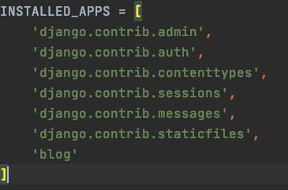
Install new app to setting

Slide 5
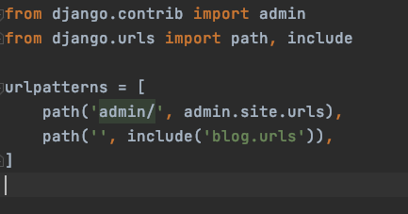
Register new app to urls
urls.py in project folder

Slide 6
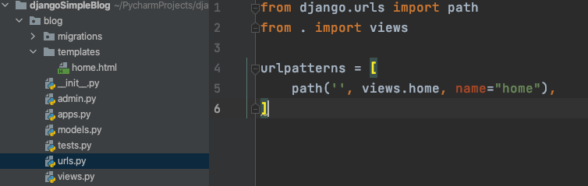
Create urls file in app folder

Slide 7
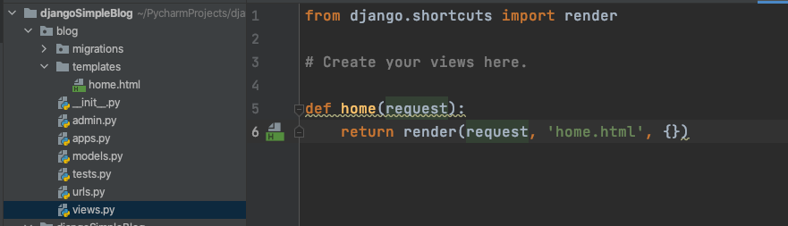
Create views

Slide 8
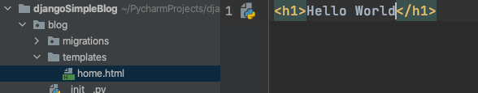
Create template

Slide 9
Create superuser
python manage.py migrate
python manage.py makesuperuser

Slide 10
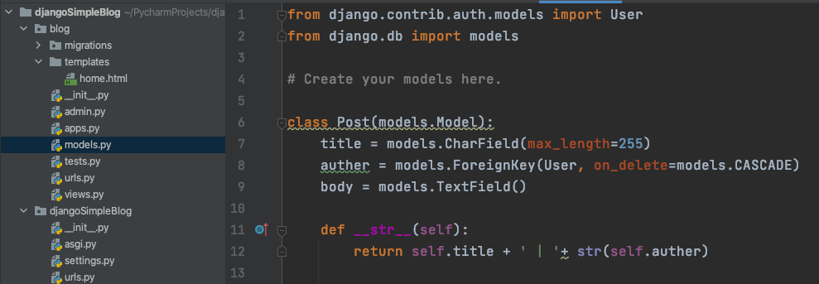
Modelling

Slide 11
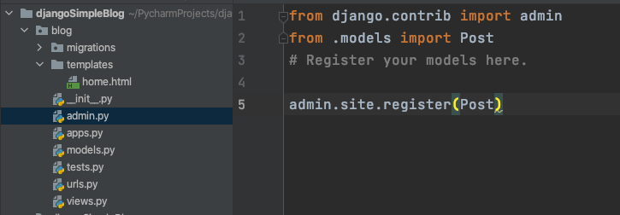
Register Models

Slide 12
Model migration
python manage.py makemigrations
python manage.py migrate

Slide 13
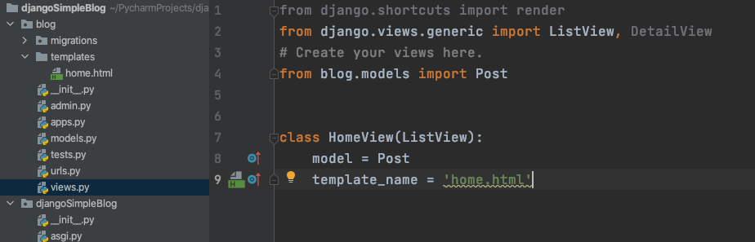
ListView
You need:
model
template_name

Slide 14
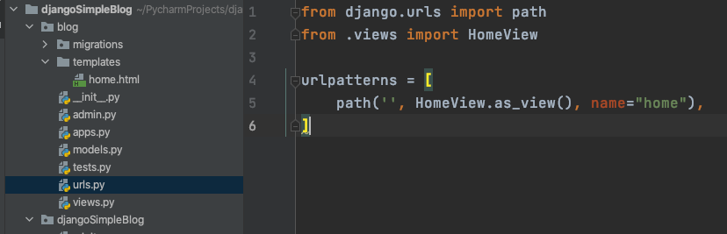
Register your view to urls.py

Slide 15
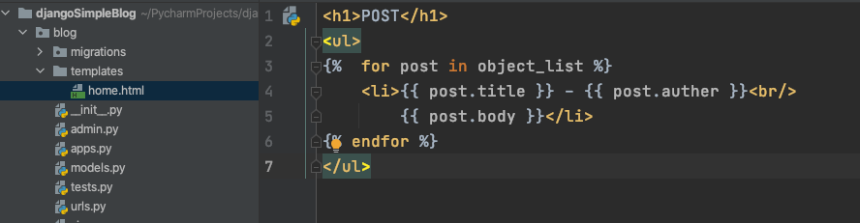
Template

Slide 16
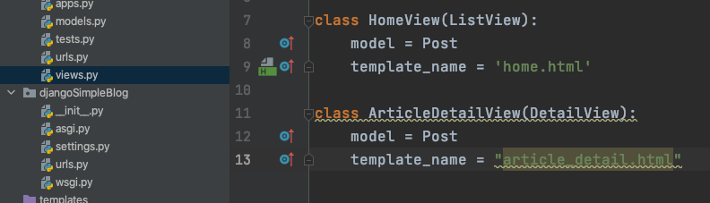
DetailView
model template_name

Slide 17
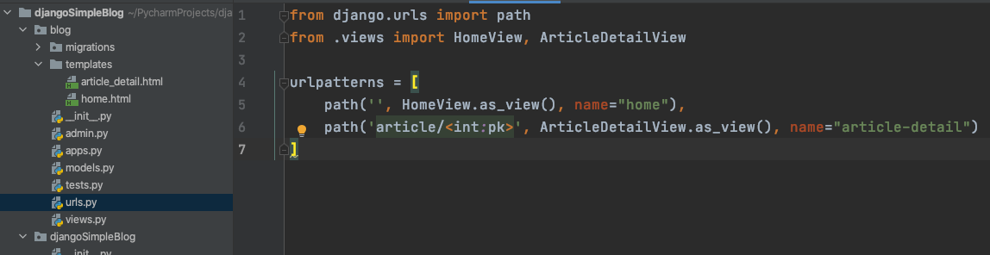
Add to urls.py

Slide 18
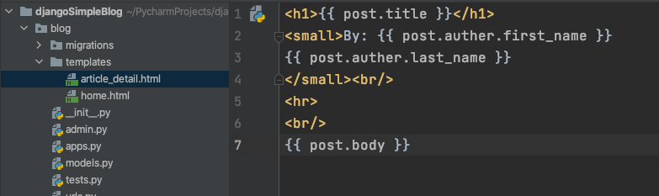
Create article_detail.html
article_detail.html

Slide 19
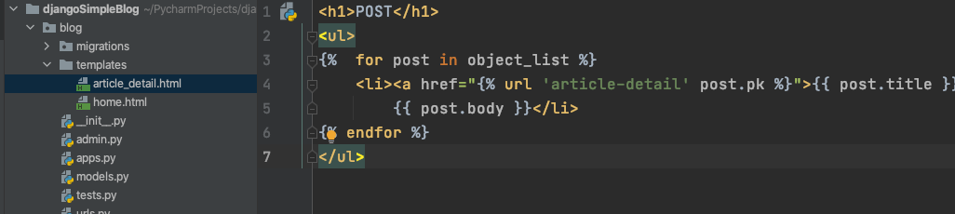
Add links to post list

Slide 20
Base.html
https://getbootstrap.com/docs/5.1/getting-started/introduction/
Copy Starter template
Change <h1>Hello, world!</h1> to
{% block content %} {% endblock %}

Slide 21
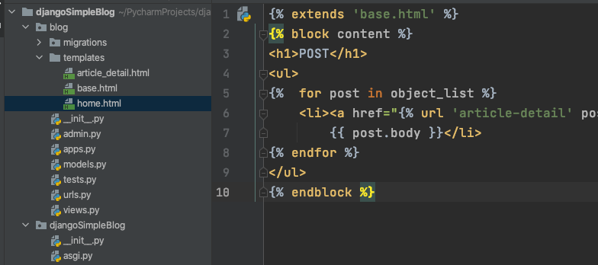
Extend from another page

Slide 22
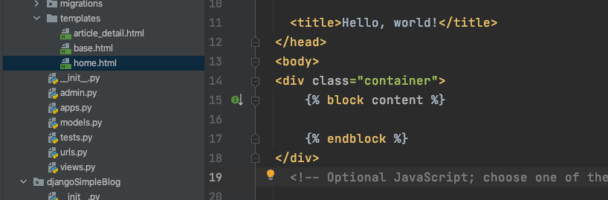
Try more bootstrap

Slide 23

Add a nav bar
https://getbootstrap.com/docs/5.1/components/navbar/
Copy nav bar code in side body in base.html

Slide 24
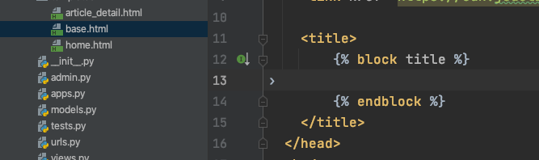
Add Title to page
In base.html

Slide 25
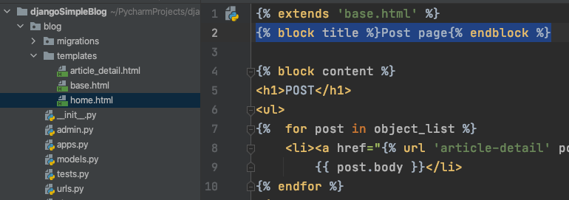
In home page

Slide 26
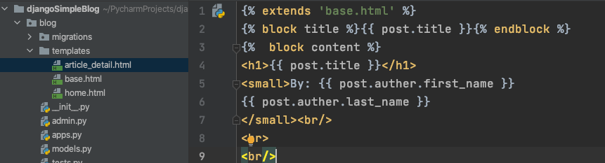
In detail page

Slide 27
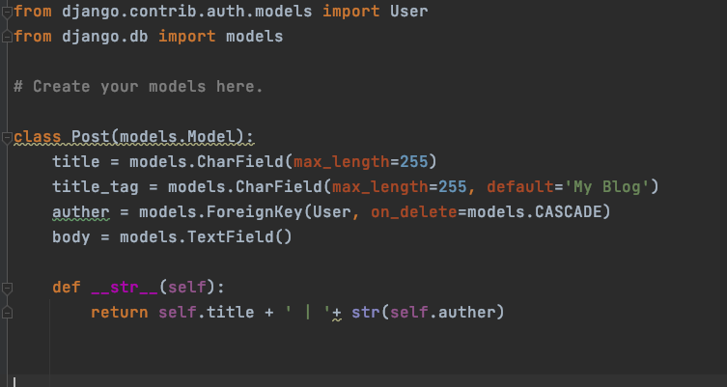
Add tag attribute to Model Post

Slide 28
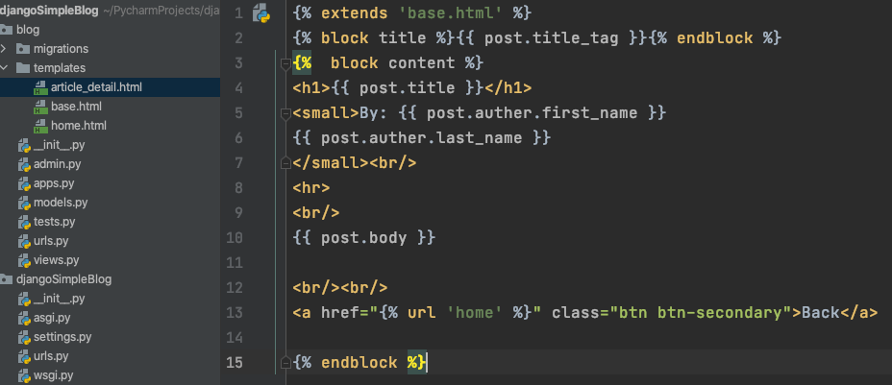
Use title_tag for title

Slide 29
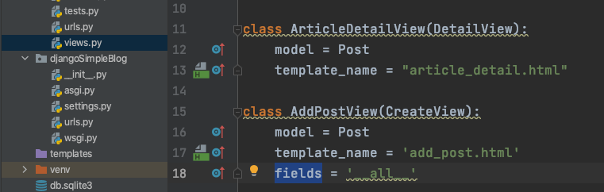
CreateView
model
template
fields

Slide 30
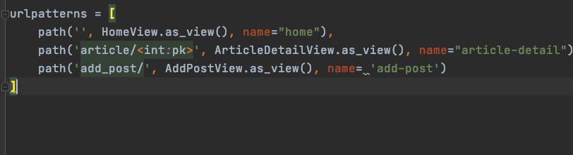
Add view to urls

Slide 31
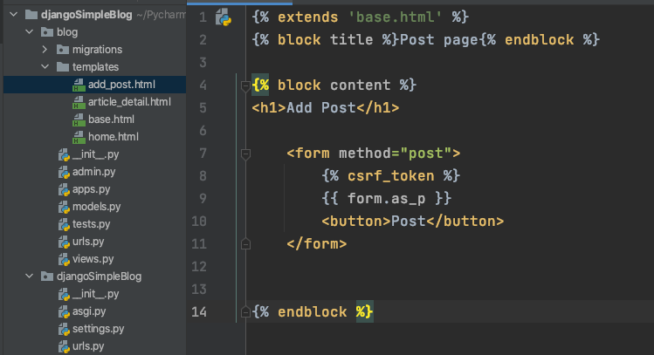
Create a form in template
Django form (https://docs.djangoproject.com/en/3.2/topics/forms/)
{{ form.as_table }} will render them as table cells wrapped in <tr> tags, you need a <table> outside your <form>
{{ form.as_p }} will render them wrapped in <p> tags
{{ form.as_ul }} will render them wrapped in <li> tags

Slide 32
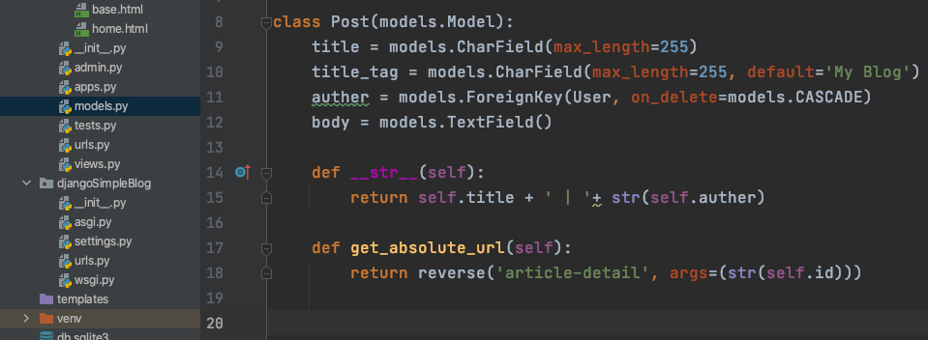
Create function get_absolute_url

Slide 33
Edit your form page title
{% block title %}Add Post{% endblock %}

Slide 34
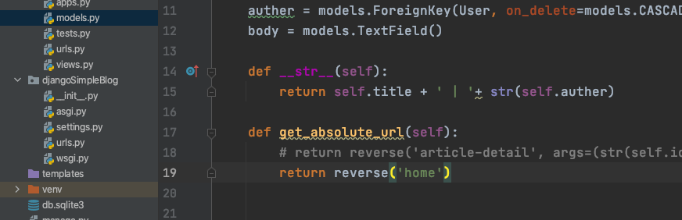
You can change go back page to home

Slide 35
Fields in CreateView can be changed
fields = ('title', 'body')

Slide 36
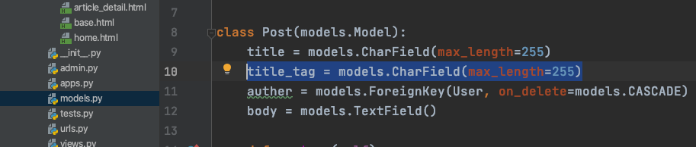
You don’t need the tag to be default

Slide 37
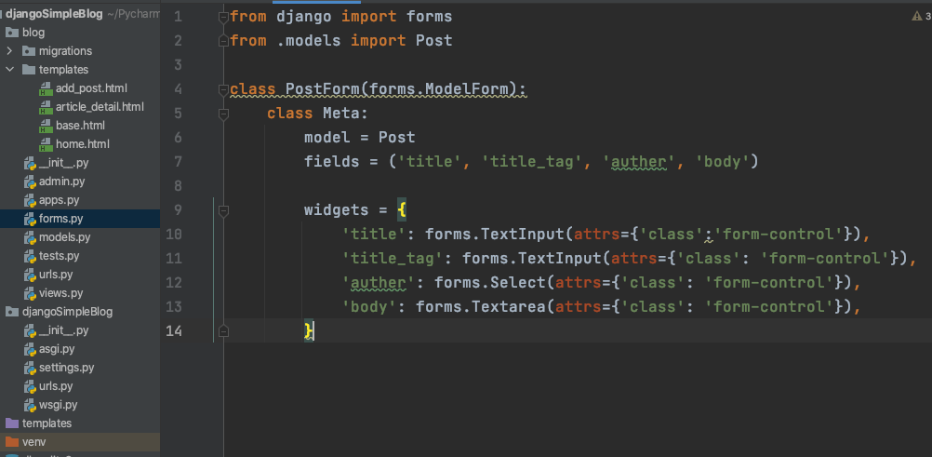
forms.py
Django has a Form class
You also can add placeholder here

Slide 38
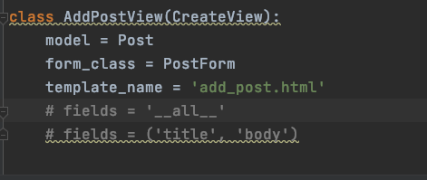
CreateView
Attribute: form_class
You don’t need fields now

Slide 39
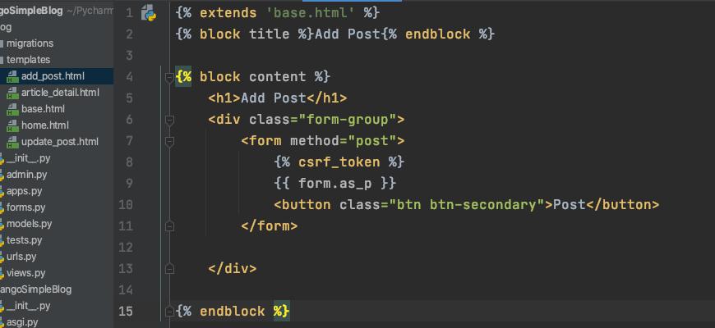
Add Bootstrap in

Slide 40
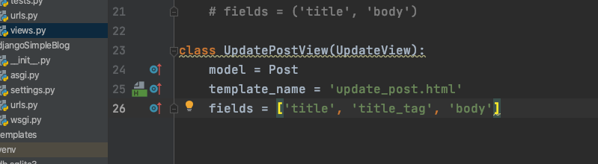
UpdateView

Slide 41
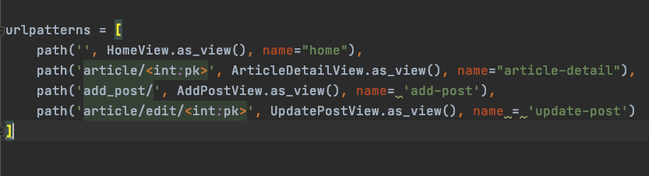
Add update view to urls.py

Slide 42
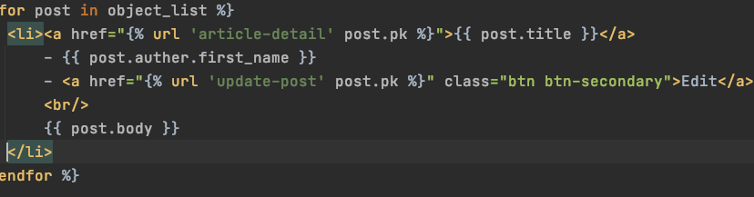
Add edit button after each post in home page

Slide 43
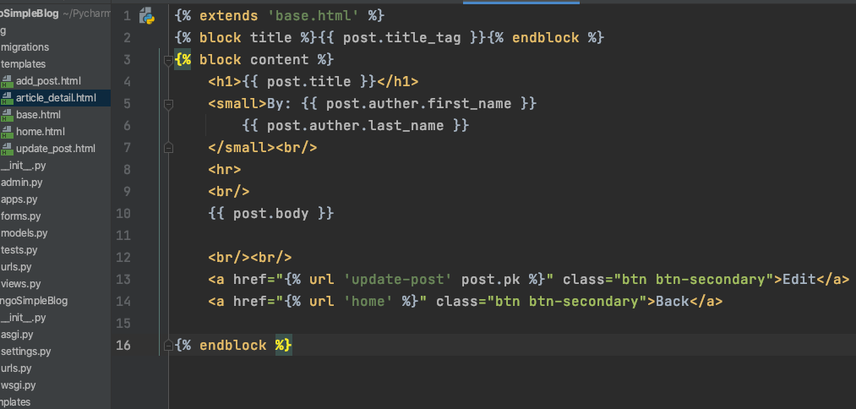
Add Edit to Detail page

Slide 44
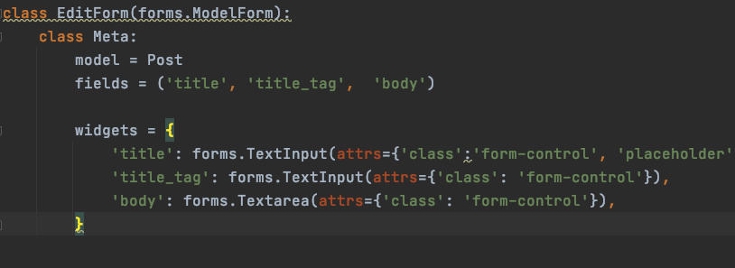
forms.py

Slide 45
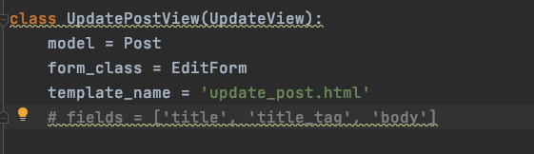
Views.py

Slide 46
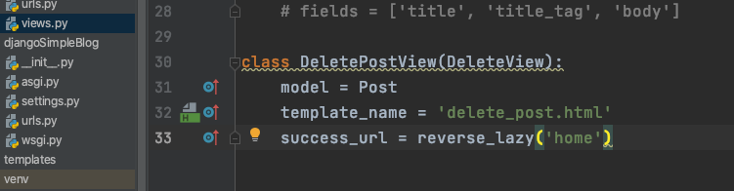
DeleteView
model
template_name
success_url

Slide 47
reverse vs reverse_lazy
reverse() function: It’s similar to the url template tag which use to convert namespaced url to real url pattern.
reverse_lazy() function: This is a reverse() function’s lazy version. It’s prevent to occur error when URLConf is not loaded. Generally we use this function in case below:
providing a reversed URL as the url attribute of a generic class-based view.
providing a reversed URL to a decorator (such as the login_url argument for the django.contrib.auth.decorators.permission_required() decorator)
providing a reversed URL as a default value for a parameter in a function’s signature.

Slide 48
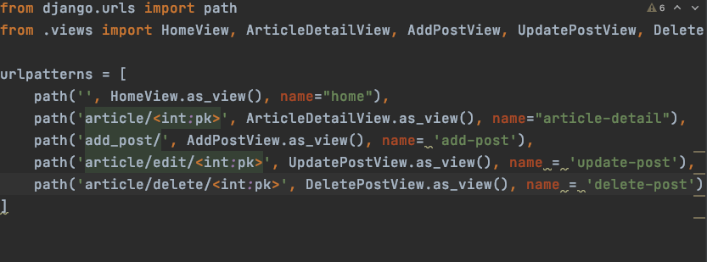
urls.py

Slide 49
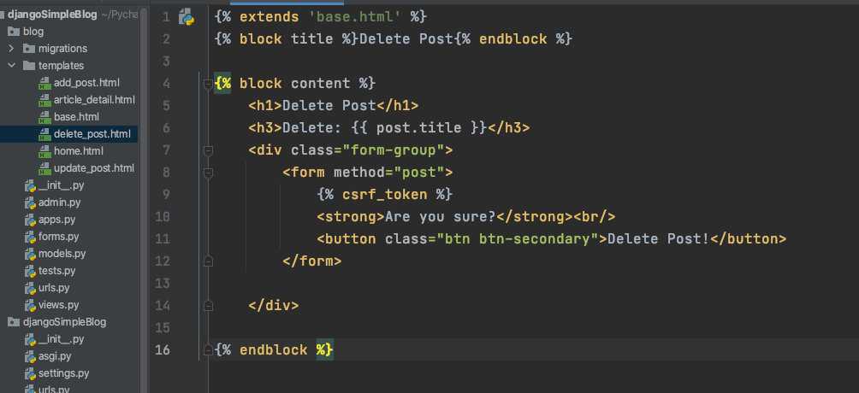
delete_post.html

Slide 50
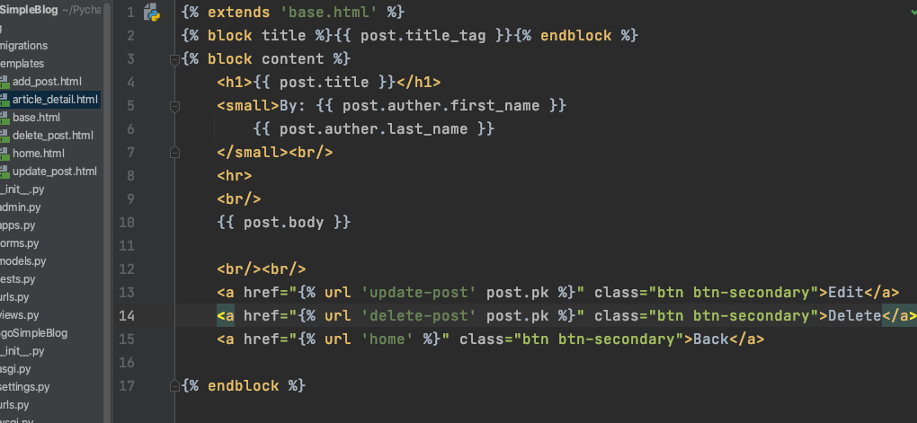
Add delete to detail page

Slide 51
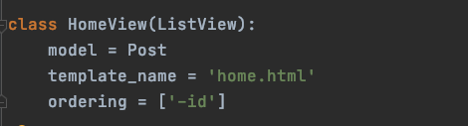
Ordering
Try remove -

Slide 52
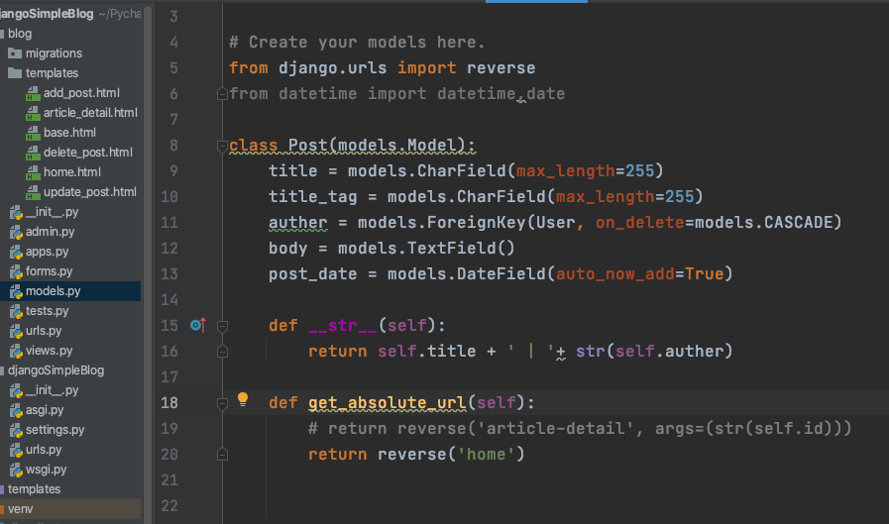
Order by Date
Add post_date to model Post
Makemigrations
migrate

Slide 53
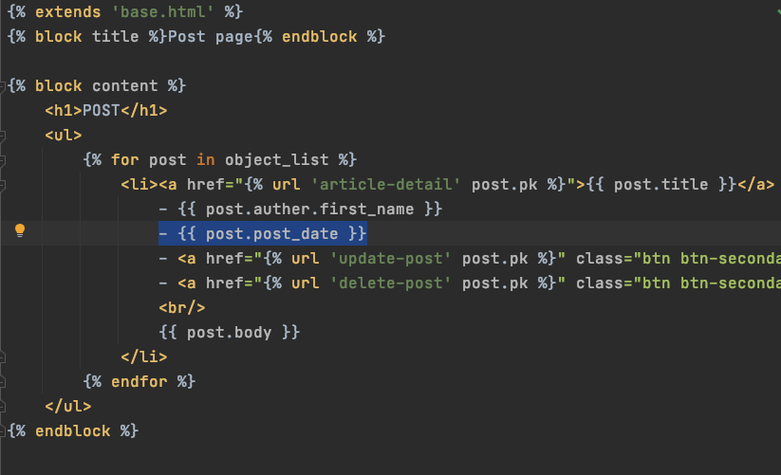
Add date to each post in home page

Slide 54
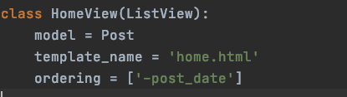
Ordering by Date

Slide 55
Source
https://www.youtube.com/watch?v=B40bteAMM_M&list=PLCC34OHNcOtr025c1kHSPrnP18YPB-NFi&index=1&ab_channel=Codemy.com
1 - 8

